Slide 1
How to Change Y-axis
of Trending Curve
Mar, 2014

Slide 2
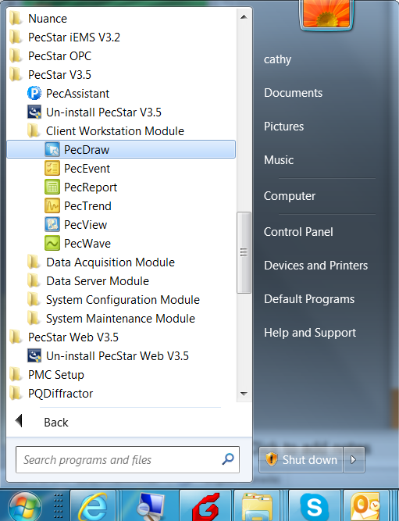
Modify the Diagram
Step 1. From Windows Start→All Programs, click PecStar V3.5→Client Workstation Module→PecDraw to start PecDraw.

Slide 3
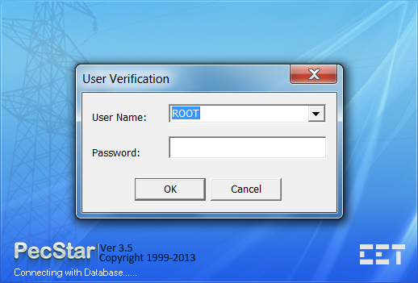
Modify the Diagram
Step 2. The User Verification Window appears. Enter the correct User Name and Password, then click OK. The supervisor user name is ROOT, no password.
Step 3. Navigate to CET\iEMS\Common\CfgCache\Graph folder, make a copy of the diagrams you want to modify in case to withdraw the operations. Change the directory to match your PecStar installation folder.

Slide 4
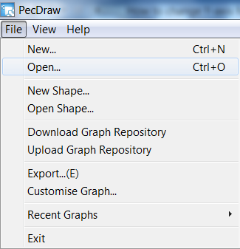
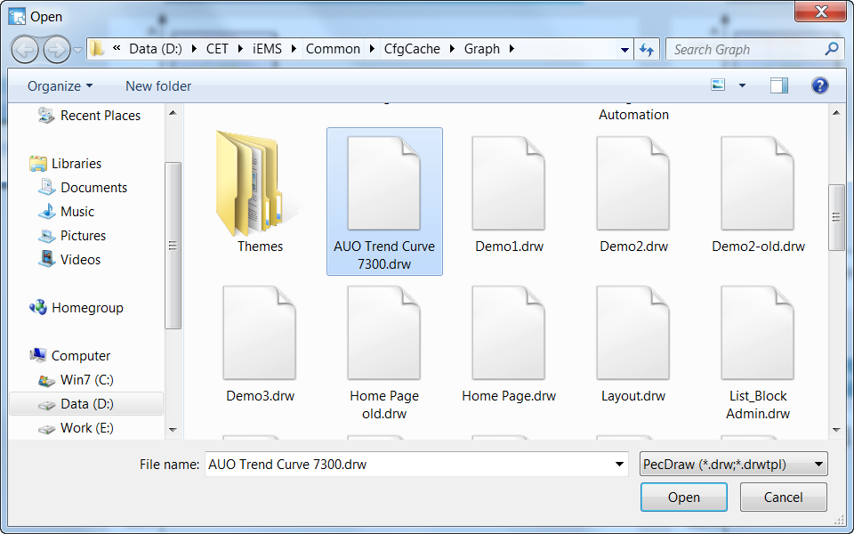
Modify the Diagram
Step 4. Click File→Open from the Menu, the Open window appears. Select the file you want to modify from CET\iEMS\Common\CfgCache\Graph and click Open.

Slide 5
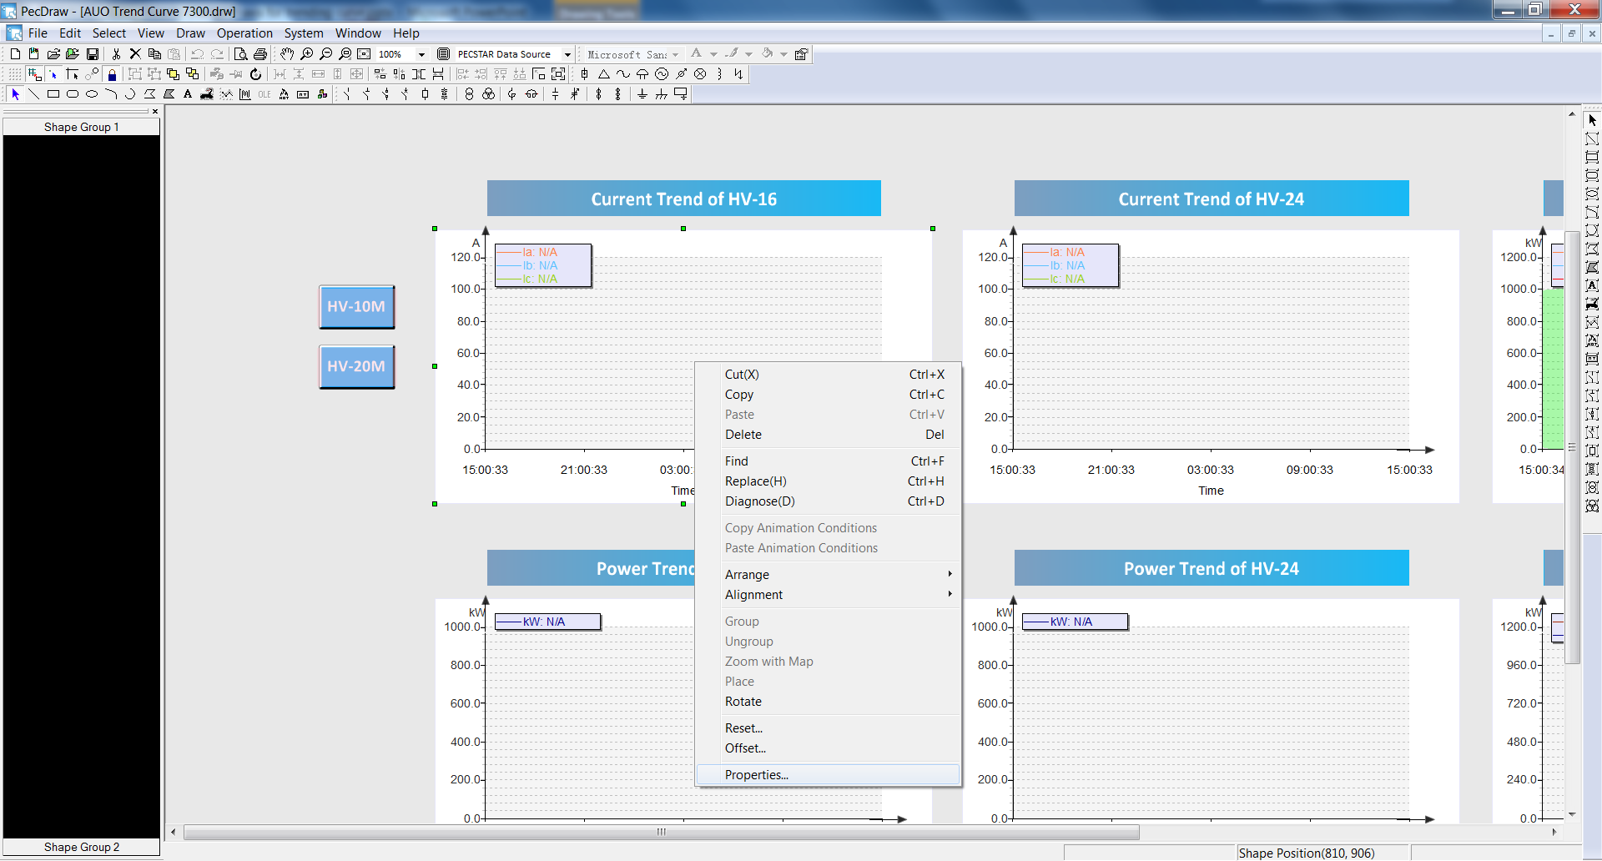
Modify the Diagram
Step 5. Right-click on the historical diagram object and select Properties… from the pop-up menus.

Slide 6
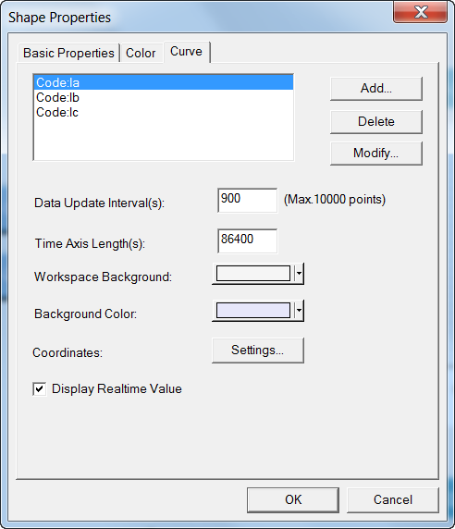
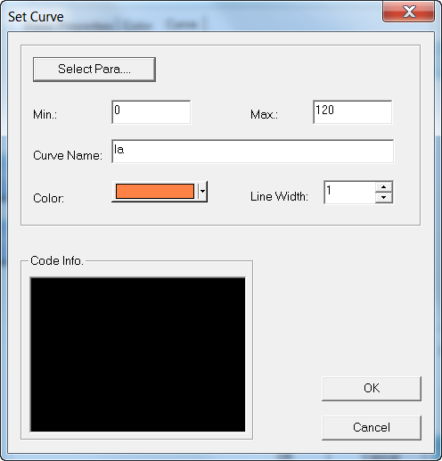
Modify the Diagram
Step 6. The Shape Properties window appears. Select the Curve tab, select the parameter and click Modify…. Then the Set Curve window appears, change the Min and Max value according to the measurements, then click OK and return to main window.

Slide 7
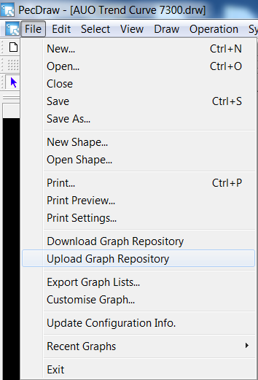
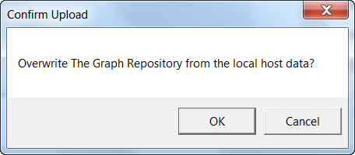
Modify the Diagram
Step 7. Click File→Save to save changes, then click Upload Graph Repository to upload the diagrams to database. The Confirm Upload window appears, click OK. Then close PecDraw.

Slide 8
Modify the Diagram
Step 8. Restart PecView.

Slide 9
Thank You

